Slide 1
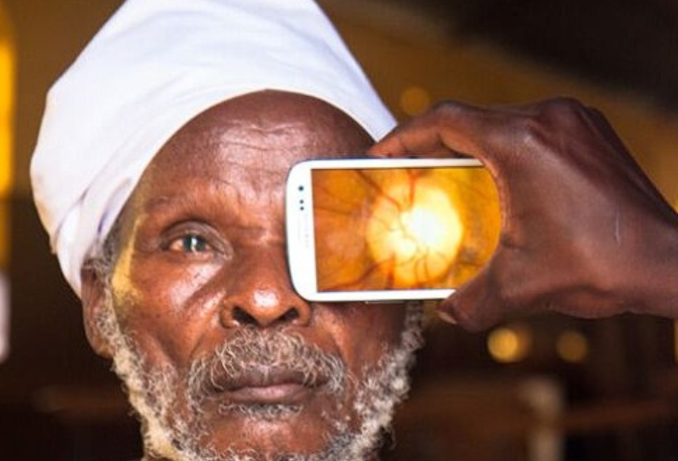

Whole Sight Eye Care Institute
Andrea Taylor Smart Technology Drives Vision Health

